Slide 1
Autonomous Mini Blimp
Team 4:
Ben Vu, Dylan Filkins, Jacob Thomas, Nick Short, Victor Albarran, Zeming Zhou

Slide 2
What was the project?
zeming

Slide 3
Concept of operations (ben)
Initial idea was to create a mini-blimp with some autonomous controls
Is able to be manually controlled (similar to RC flight) by user
Notes:
Ben

Slide 4
Initial Plan
The initial plan was to develop an autonomous blimp prototype for two scenarios (office use for Galois and DARPA competition).
The office environment would be to relay information and messages to employees.
The DARPA competition required the blimp to perform in a Quidditch like match to showcase capabilities
Considerations by Galois and DARPA would be considered for autonomous operating and outside influences (wind, image recognition, attacks, etc)
Due to COVID-19 impacts the scope of the project was changed to focus efforts on office use.

Slide 5
Actual Plan

Slide 6
IP and Prior work (Nick)

Slide 7
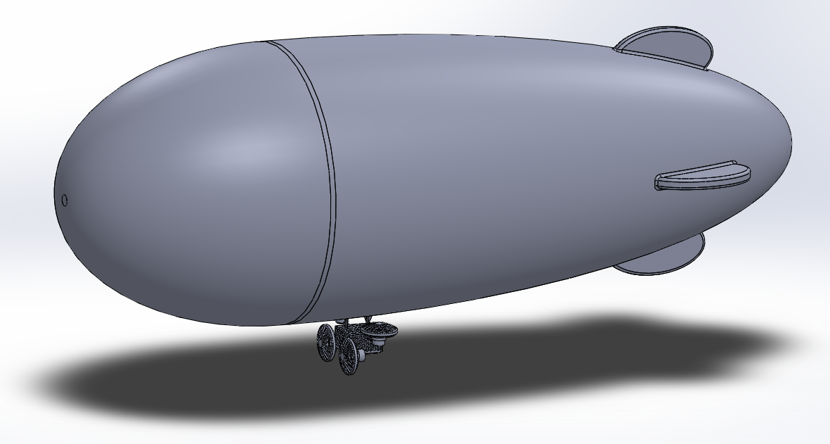
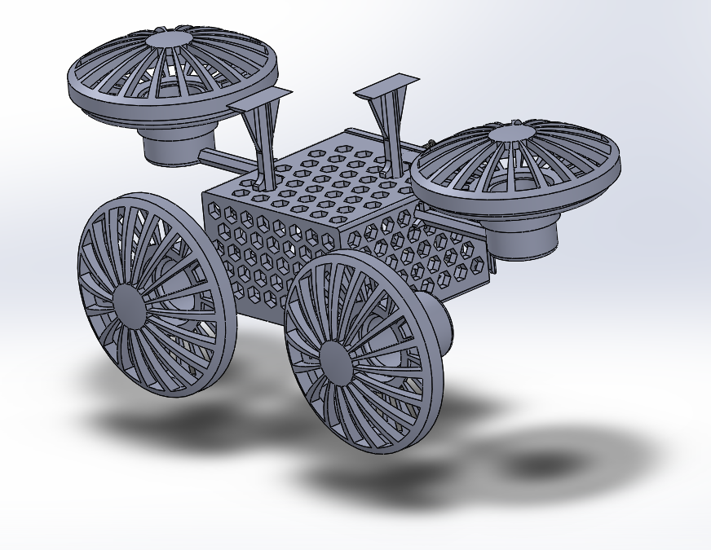
Diagram
Chassis Specifications:
~ 22 x 10 x 8.5 cm
80 grams without components
PLA
Chassis Considerations:
Airflow over electrical components
Shroud over propellers
Protection of electrical components
Modularity in propeller placement

Slide 8
Overview of software

Slide 9
Testing/ test plans (Victor)

Slide 10
Demonstration CoppelliaSim (Nick)

Slide 11
Demonstration WeBots (Victor)

Slide 12
What was achieved

Slide 13
Post Mortem
ben
Notes:
Ben

Slide 14
Contributions
Ben Vu - Documentation, SolidWorks, Github
Dylan Filkins - SolidWorks, Documentation
Jacob Thomas - Documentation, Simulation,
Nick Short - Simulation, Documentation
Victor Albarran - Simulation, Github, Documentation
Zeming Zhou - Simulation,Documentation
Collaboration site here

Slide 15
Questions?

